Slide 1
Object Oriented Programming
Week 8
Abeer GAUHER
Email: abeer.gauher@nu.edu.pk
Office: CS BASEMENT 2, Office number 17

Slide 2
Operator Overloading
Operator overloading in c++ is one of the best features that is used to overload most of the operators like “+” “–” “*” “/” “=” “.” “,” .
Type of polymorphism in which an operator is overloaded to give it the user-defined meaning.

Slide 3
Operator Overloading
Format
The name of an operator is always a conjunction of the keyword operator and the operator symbol itself. Examples: o operator+ o operator++ o operator<< o operator==
So the format of an operator overload declaration is just like that of a function, with the keyword operator as part of the name: returnType operatorOperatorSymbol (parameterList);

Slide 4
Operator Overloading
The syntax for operator overloading:
Class class_name
{
Public
Return_type operator symbol (argument ())
{
}
………………………….
};

Slide 5
Operator Overloading
The Thee ways
1. Member function
2. Nonmember function
3. Friend function
Member function
The first way is by class method (member function). This is the most popular way.
Usually overloading operators as member operators rather than as nonmembers. Bit more efficient since the definition can directly reference member variables.“

Slide 6
Operator Overloading
Member function
Since the operator is applied on a (existing) class object, the number of parameters to the operator is one less:
Binary operators have 1 parameter, the second operand to the operator. The first operand is the object in which the overloaded operator is called/invoked.
Unary operators (e.g. unary - for negative) have 0 parameter.

Slide 7
Operator Overloading
NonMember function
Another way to overload operators is by regular, non-member functions.
Since the operator is NOT a class method, all operands involved in the operator become the parameters:
Binary operators have 2 parameters, the second operand to the operator. The first operand is the object in which the overloaded operator is called/invoked.
Unary operators have 1 parameter.
Also the operator cannot access private members in the parameter objects.

Slide 8
Operator Overloading
Friend function
Yet another way is to use friend function. Friend functions are declared within a class, but they are NOT class methods.
A friend function is actually a regular function which has a privilege to access private members in the parameter objects.

Slide 9
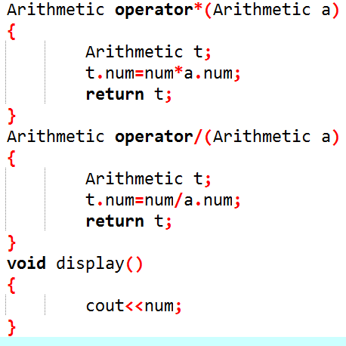
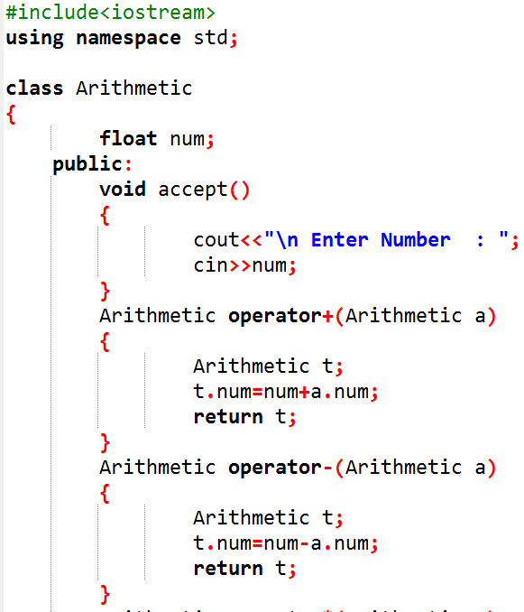
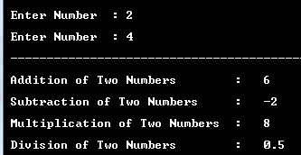
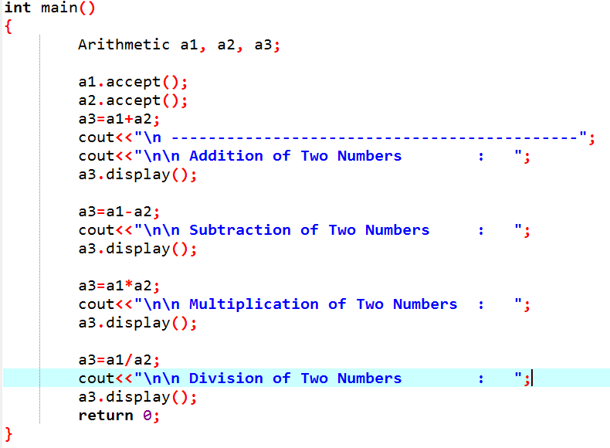
Operator Overloading
Binary operators: + - / *

Slide 10
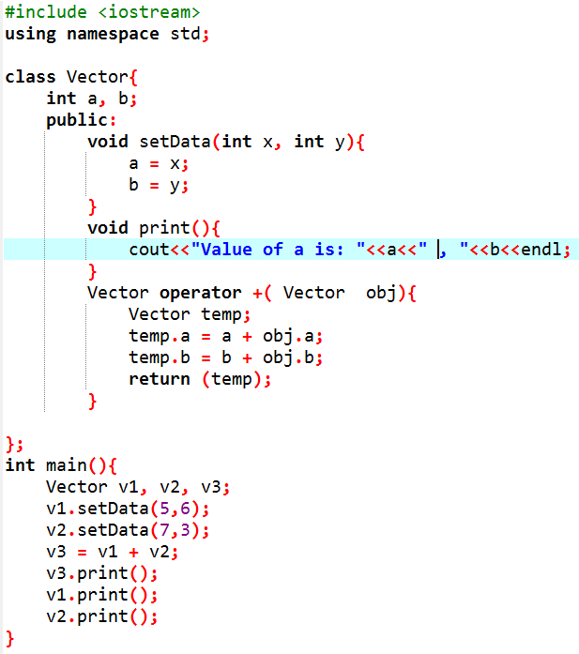

Operator Overloading
Binary operators:

Slide 11
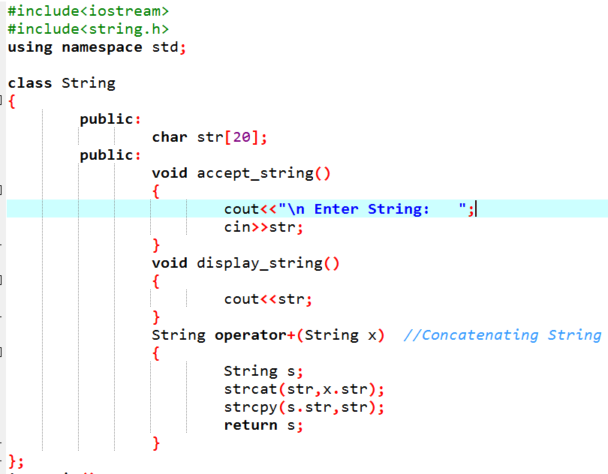
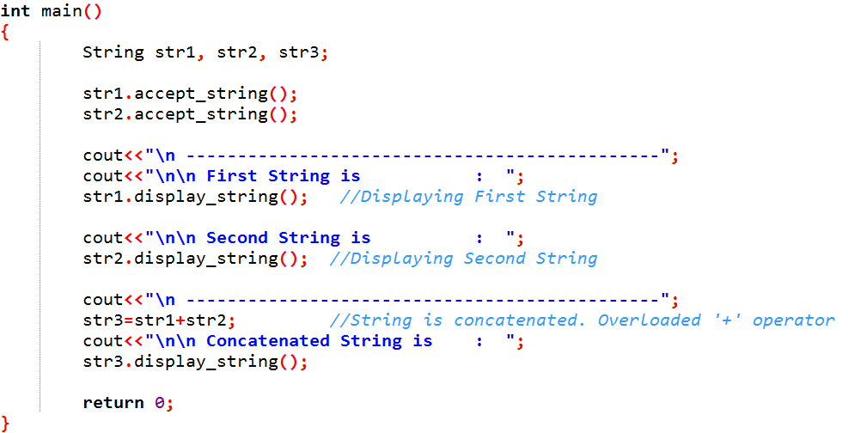
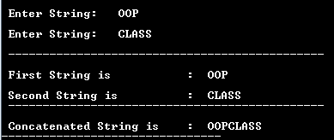
Operator Overloading
Binary operators:

Slide 12
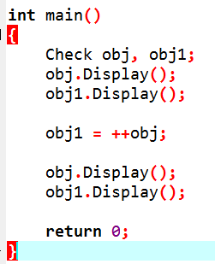
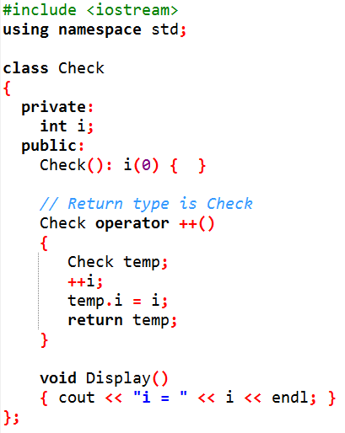

Operator Overloading
Unary operators:
The return type of operator function is Check in this case which allows to use both codes ++obj; obj1 = ++obj;. It is because, temp returned from operator function is stored in object obj.
Since, the return type of operator function is Check, you can also assign the value of obj to another object.
Notice that, = (assignment operator) does not need to be overloaded because this operator is already overloaded in C++ library.

Slide 13
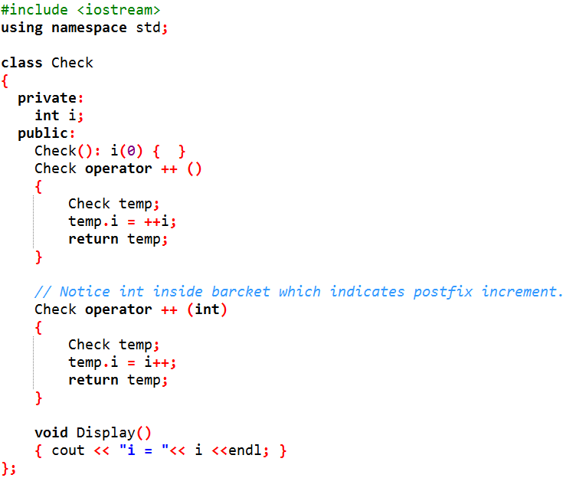
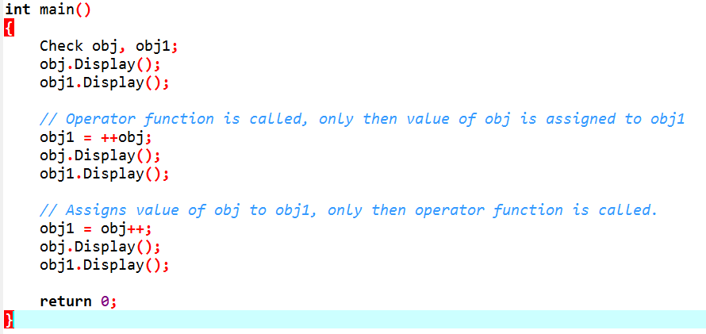

Operator Overloading
Unary operators: ++operator

Slide 14
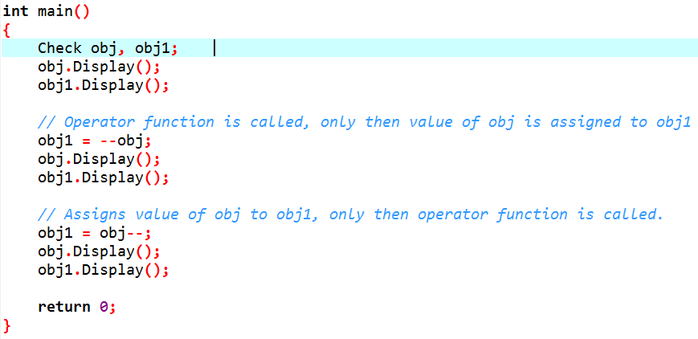
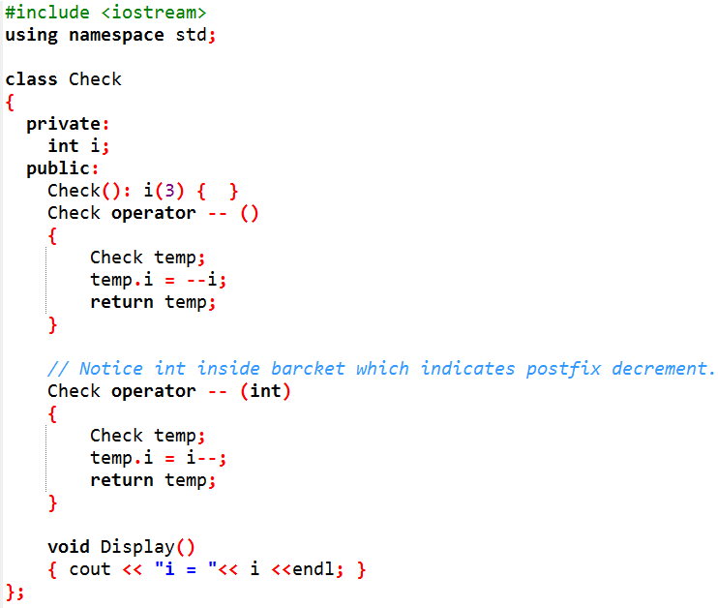

Operator Overloading
Unary operators: - -operator

Slide 15
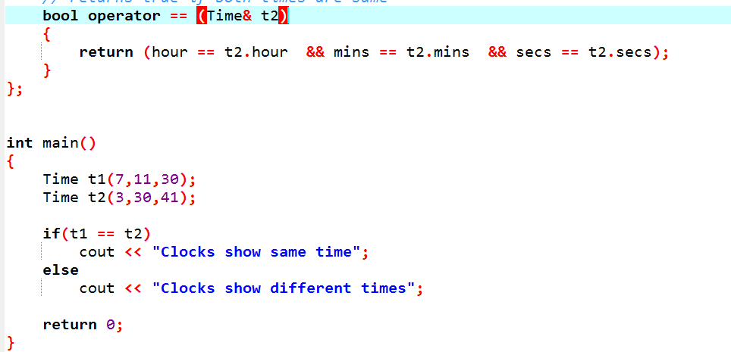
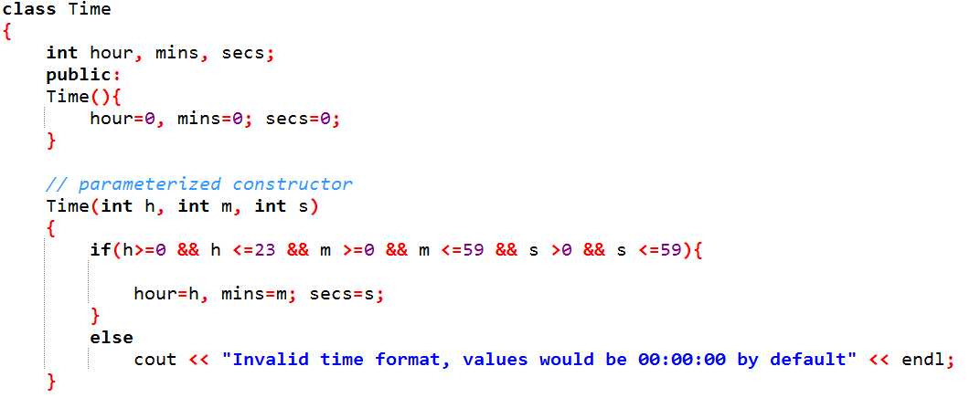
Operator Overloading
== operator

Slide 16
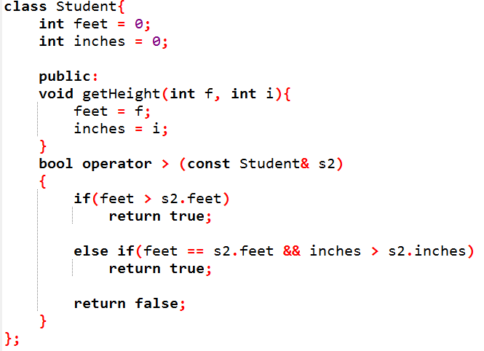
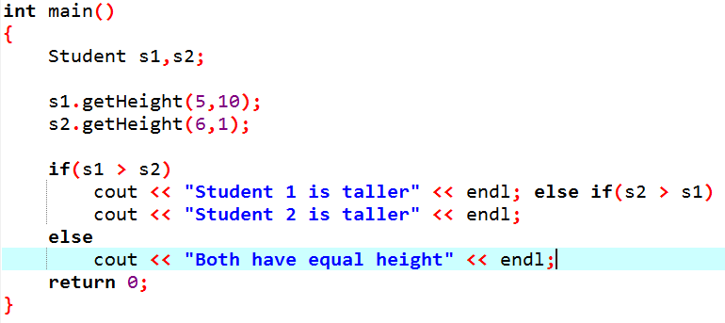
Operator Overloading
> operator

Slide 17
Operator Overloading
Function Call Operator
Function call operator is overloaded by instance of the class and it is also known as function object.
When we overload function call operator, we are not creating a new way to call a function. But, we are creating an operator function that can be passed a number of parameters.
It only modifies how the operator is to be fetched by the object.
class class_name
{
public:
void operator ()();
};

Slide 18
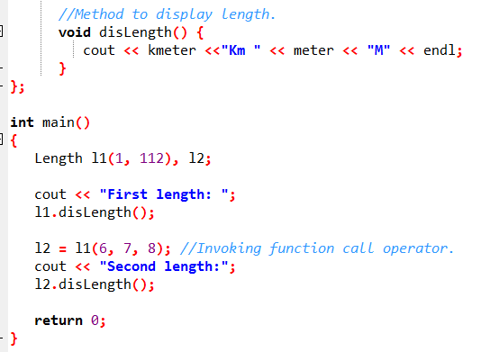
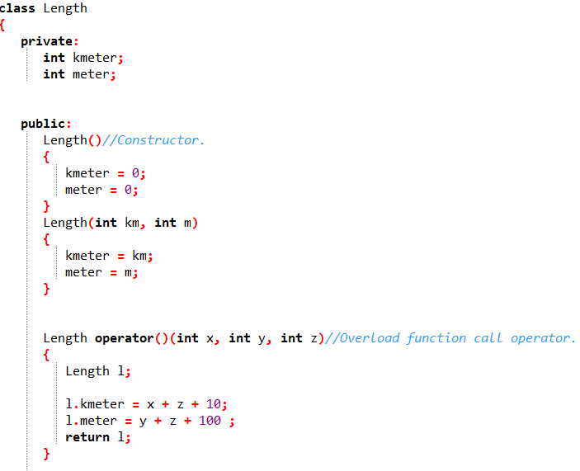

Operator Overloading
Function Call Operator

Slide 19
Operator Overloading
Overloading an operator cannot change its precedence.
Overloading an operator cannot change its associativity.
Overloading an operator cannot change its "arity" (i.e. number of operands)
It is not possible to create new operators ones.
The following operator can only be overloaded as member functions: =, [], ->and ().
The following operator cannot be overloaded: the dot operator (.), the scope resolution operator (::), sizeof, ?: and .*.

